Slide 1
Alternative Grading Methods
AKA the WEIRD SCIENCE and Art of
META-Psychology

Slide 2
META-Psychology
Self-referential
Going beyond
After, before, behind and between (my favorite prefix)
META gaming – Most Effective Tactics Available
“Gaming the System”, low stakes, avoid cheating, AI and plagiarism
Don’t hate the “player” hate the “game”.

Slide 3

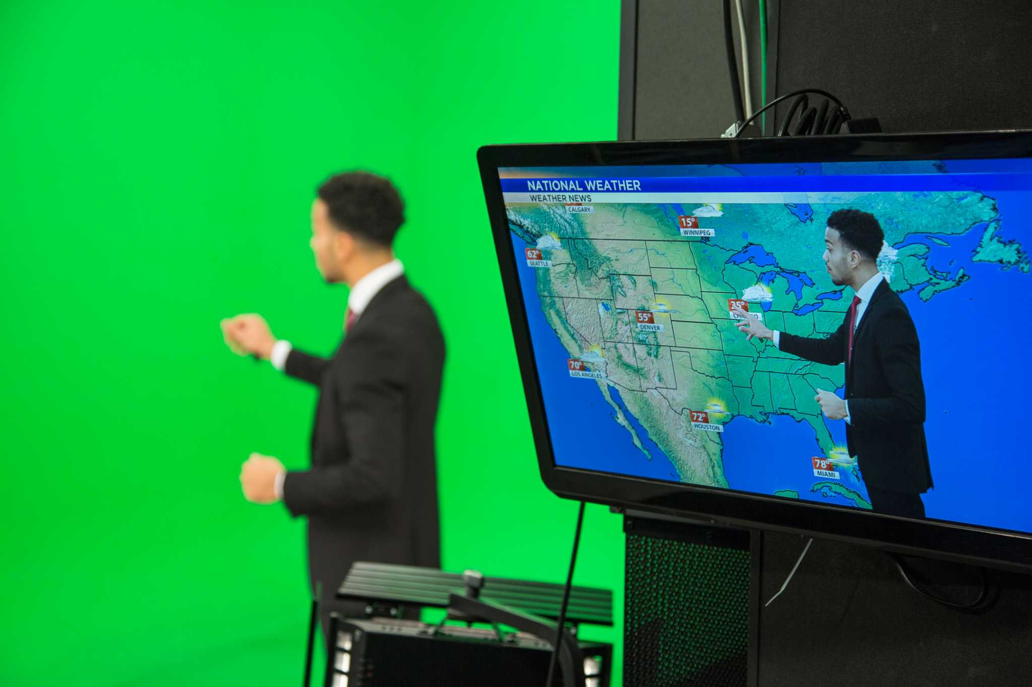
Most likely to become a game show HOST
Me-teorology
Guide on side vs. sage on stage
Meat versus Cheese – Preacher vs. Teacher

Slide 4
Gamification – REWARDS over Punishments
gamification
/ˌɡāməfəˈkāSHən/
Gamification is the process of integrating game design elements—such as points, badges, leaderboards, and rewards—into non-game contexts to increase user engagement, motivation, and participation
Benefits and Drawbacks
Benefits: Higher engagement rates, better knowledge retention, immediate feedback, and turning routine tasks into enjoyable habits.
Drawbacks: Risk of superficial engagement, potential overcompetition anxiety on leaderboards, and reliance on extrinsic rewards rather than true intrinsic motivation. [1, 2, 3, 4]

Slide 5


5 +/- 1 “Buckets”…
5 “Exams”/Quizzes
15 SGs (5x3)
Final Exam (& Review)
First/Final Papers
Final Presentation
FPARTS
Start PART and Final PARTs
Only UP! 2000pts, $1800 is an A!
Absences and F bombs
2 “vacation/personal” days.

Slide 6
Grade Worksheet
The following form is designed to help you follow the progress of your evaluation. There are 20 major grades and unknown amounts of extra credit, averaged together for your final grade:
 | Points Earned | Possible Points |  |  | Points Earned | Possible Points
Exam 1 |  | 50 |  | SG1 Chapters 1,2,3,5 |  | 100
Exam 2 |  | 50 |  | SG2 Chapters 4,6,8,7 |  | 100
Exam 3 |  | 50 |  | SG3 Chapters 10,14,11 |  | 75
Exam 4 |  | 50 |  | SG4 Chapters 15,16 |  | 50
 |  |  |  | SG5 Chapters 9,12,13 |  | 75
First Paper (FP1) |  | 100
Final Paper (FP2) |  | 100 |  | Class PARTicipation 1 |  | 200
 |  |  |  | Class PARTicipation 2 |  | 200
Final Course Review (FR) |  | 100 |  | Class PARTicipation 3 |  | 200
Final Exam |  | 100 |  | Class PARTicipation 4 |  | 200
 |  |  |  | Class PARTicipation 5 |  | 200
Final Presentation (FP3) |  | 100 bonus
 |  |  |  | Total Class Points |  | 2000

Slide 7
Final Grade Your final grade will be earned by demonstrating a level of proficiency as shown below; there is ample extra credit available to you, so no further consideration, arguments or augmentations will be made.
A Average grade of 90 or above = 1800 points or more
B Average grade of 80-89 = 1600 points or more
C Average grade of 70-79 = 1400 points or more
D Average grade of 60-69 = 1200 points or more
F Failure to earn credit due to grade below acceptable levels (60) or below 1199pts
The BEST WAY to get an estimate of your grade is to just COUNT UP your TOTAL NUMBER OF POINTS!
Percentages can be misleading in this course because there are SO many points available in various formats (points is points, remember!?). So, just shoot for the TOTAL number of points you would like to earn (kind of like a 10K to an A)!

Slide 8


PARTS
Devo Debit
200pts on average, 300 max
200pts to START (attendance bonus)
555s/101010s/303030s/505050s/100s
Malleable, memorable, snacks versus meals
The illusion of “choice”
Pudding/Meat/Pablum
RRR

Slide 9
PARTS – Not-so-simple-sample-syllabus!
Class Participation (PART) Success in this class is dependent on practice and “playing” with the material. There is a significant amount of terminology and multiple exposures to the material in a variety of formats are important. Participation in “in-class” and “out of class” exercises, discussions, and/or activities are very helpful in triggering recall for class concepts. In fact, you will PROBABLY remember and ENJOY more of these PART activities than anything else in the course! Class participation will be measured via the completion and discussion of homework, other “in-class” activities, demonstrations, as well as subjective appraisal of student performance. There will be a LOT of small, often impromptu, class assignments made in class (and via the power points), but to be completed mostly outside of class, to help you understand and apply the material in a fun, friendly and fast way. Class Participation SHOULD track at about 100 points per test and therefore also comprises about 1/5th (20%) of your course grade! Again, if you don’t do THESE you will only get a C in the class. HOWEVER, anything BEYOND the 100 points per exam WILL be EXTRA CREDIT but basically this is your *BEST way to… work your way to an A! These participation assignments are called… 5/5/5s, 10/10/10s, etc. and involve about 5 minutes, 5 sentences, for 5 points, or 10/10/10 and so on. The 5/5/5s will be 5 bullets/notes/sentences and then an RRR (see paper guidelines on page 3) the 10/10/10 will be a bit more (10 sentences or bullets and THEN end with an RRR, and so on). These will often be things off of the web like YouTube, Wiki(pedia), etc., and will be assigned points based on the length of the video or article 5/5/5, 10/10/10 etc. with SOME 30/30/30s, 60s, 90s, etc. Also, there are… 26 Discovering Psychology (Disco Psych) videos online https://www.learner.org/series/discovering-psychology/ with Dr. Phillip Zimbardo, which are up to 30/30/30 opportunities and therefore up to 780 points total!!! Just follow along (or backtrack) with the course schedule (on the last page of this syllabus, where it says “Disco Psych”) where they are listed with their corresponding Chapter (on the last page of this syllabus). These bullets must demonstrate that you watched the whole video and the RRR should involve THOUGHT! I also provide a list of Crash Course Psychology videos on D2L as they correspond to the course. These videos are available on You Tube for 101010s and there are 40 of them for up to 400 points! Some portions of these videos will be shown in class lecture: https://www.youtube.com/results?search_query=crash+course+psychology 780 + 400 is 1180 points! Which means you can almost earn a D just by doing ALL of these movies! But is over 24 hours of video! Finally, you can watch my pre-recorded lectures, of which there will be about 20x2 hours each for 100/100/100 IF you miss a class and would like to make up the points…YOU CAN ONLY DO 300pts MAX per EXAM period, you should average 200pts per exam period. LOTS of ways to earn an A!

Slide 10
RRR
GENERAL PAPER GUIDELINES FOR ALL PAPERS- RRR(R)
ALL PAPERS (LOs, FPs, PARTs) MUST END WITH A REVIEW/ REFLECT/RELATE & (RATE) (RRR(R)) over the entire assignment (i.e.: what you did, why you did it, how you did it and did you DIG it) which should come AFTER your paper’s concluding paragraph or bulleted points (unless otherwise instructed) and this reflection should be written in the first person. You should review, reflect, relate and rate the assignment on a scale of 1-10 and put the rating in parenthesis or circle please. For example…REVIEW - I watched the trailer/clip about (blank) because I found it or you told me to or in class, and the clip showed/talked about (blank), it RELATED to the current topic(s) and AT LEAST ONE text term/concept because (yadayadayada), REFLECTING BACK I can see where this was/was not a good example or why you showed it because (yadayadaya), so…I would RATE it a (blank) out of 10, because it was cool, stupid, pointless, whatever! Fair on the side of writing too much on these for full or even EXTRA credit!

Slide 11
Devo Dollars/Debit
Devo Dollar$ and Debit (DD) What’s better than money? How about EVEN MORE EXTRA CREDIT! “Devo Dollars” are handed out for various rewarded “behaviors” during class. They are given on a variable reinforcement schedule (ask on 2nd day for +5 ☺), so come to class, pay attention, participate, and you may be given some of these ‘rarities’. I actually give out so many points and options that I will also ask you to keep a Devo Debit Sheet to keep track of these points, because you can earn so many! Next person to ask me for an example on day two gets +5!

Slide 12

Devo Dollars…Devo Debit

Slide 13
 | Devo Debit Card
Name | "Account" #
Date | Description | Amount

Slide 14
“Extra” Credit?
Basically, there is NO SUCH THING AS EXTRA CREDIT! “Points is points”, so I suggest you do the “core work” (exams, study guides, etc.) but even THESE can be compensated for by doing better or MORE in other areas. It is like a cafeteria of credit…where you pick what you like and eat a lot of it, but don’t forget the main “course”. The text is the “meat” and I am the “cheese”☺. First to ask me more about this on day 2 gets +5!

Slide 15
Observations
Students are confused at first (like you)!
95%+ stay in it the first weeks
Most figure it out without need of email, phone call or Webex.
Makes learning fun, flexible, and fair.
Can remove the scaffold and student keep going up!
RRR allows for some deeper reflection and retention.

Slide 16
Future directions
Achievement Awards
Honor Chords
D2L

Slide 17
Questions? Suggestions? Objections?

