Slide 1
3d Bioprinting
Accelerating new drug discovery & providing new hope for organ transplantation

Slide 2
Agenda
Introduction – How Did We Get Here?
What is 3D Bioprinting?
Why 3D Bioprinting Matters
Current Progress & Challenges
Future Perspectives
Student Perspectives & Experiences

Slide 3
How did we get here?

Slide 4
Biomanufacturing &
Regenerative medicine

Slide 5


Our world
Is changing

Slide 6

Our world
Is changing

Slide 7
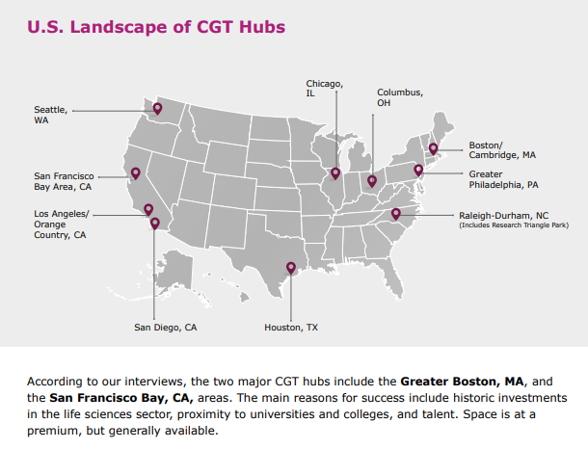
Our world
Is changing

Slide 8
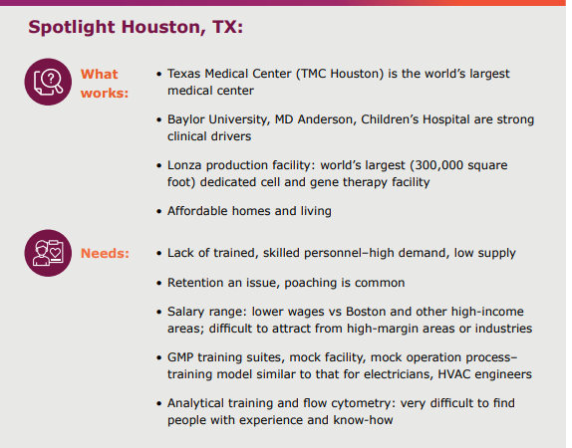
Our world
Is changing

Slide 9
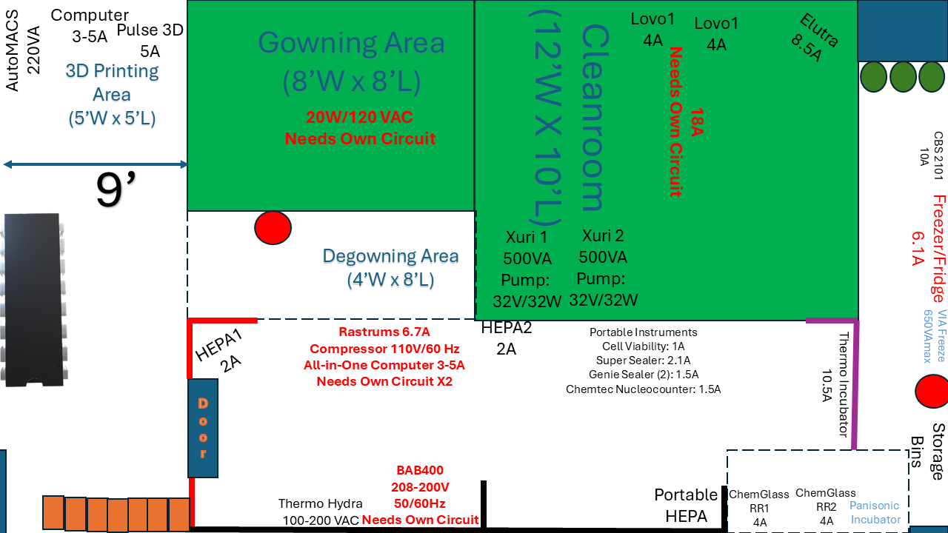
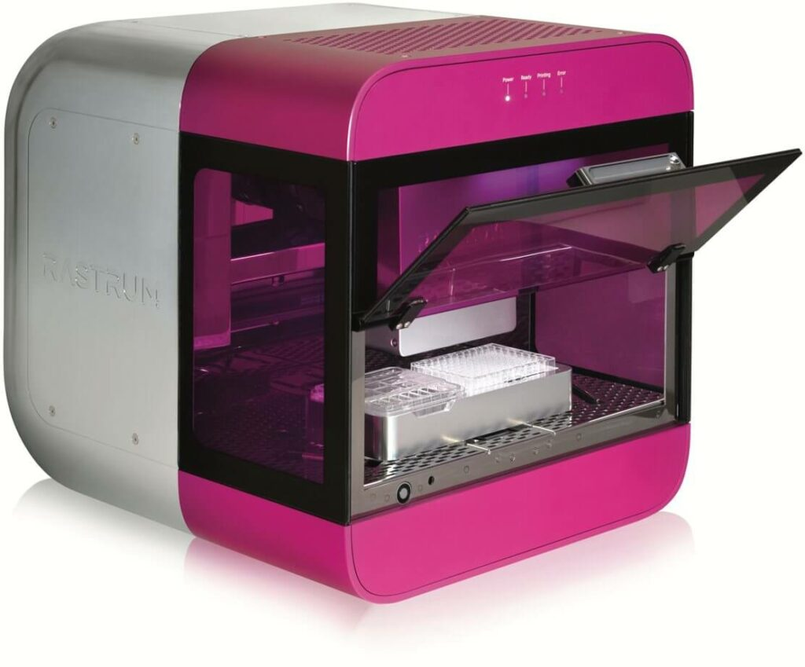
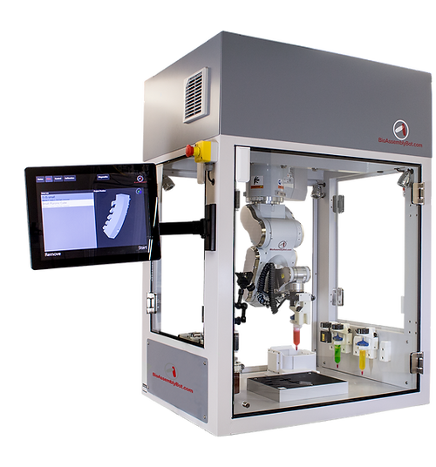
LSC Biotechnology (and others!) will be part of this emerging ecosystem

Slide 10

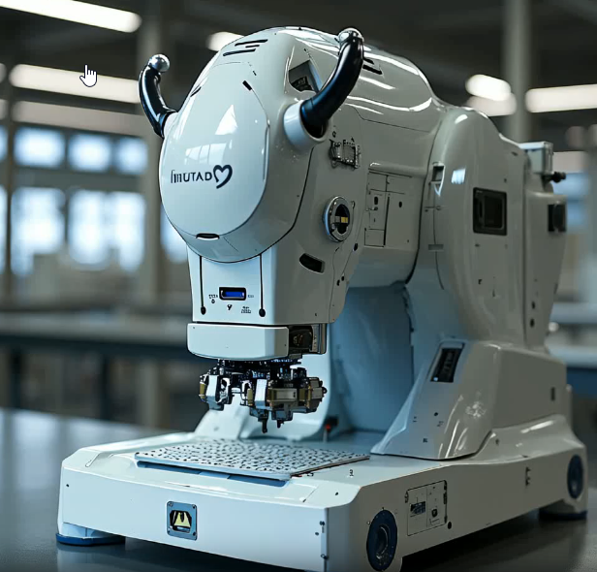
Additive manufacturing
A type of manufacturing where products are generated from a digital image by adding material, layer by layer

Slide 11
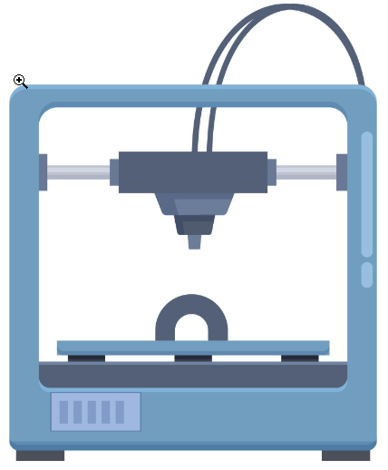
Additive manufacturing
A type of manufacturing where products are generated from a digital image by adding material, layer by layer

Slide 12
Additive manufacturing
A type of manufacturing where products are generated from a digital image by adding material, layer by layer

Slide 13
Additive manufacturing
A type of manufacturing where products are generated from a digital image by adding material, layer by layer

Slide 14
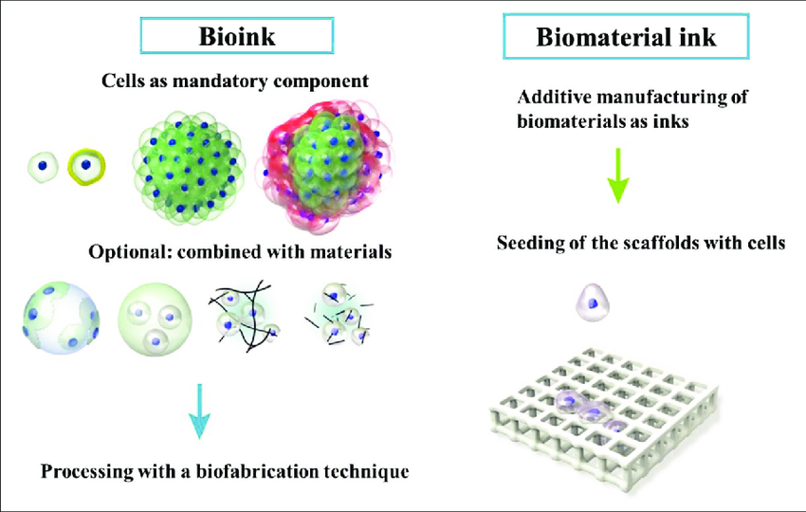
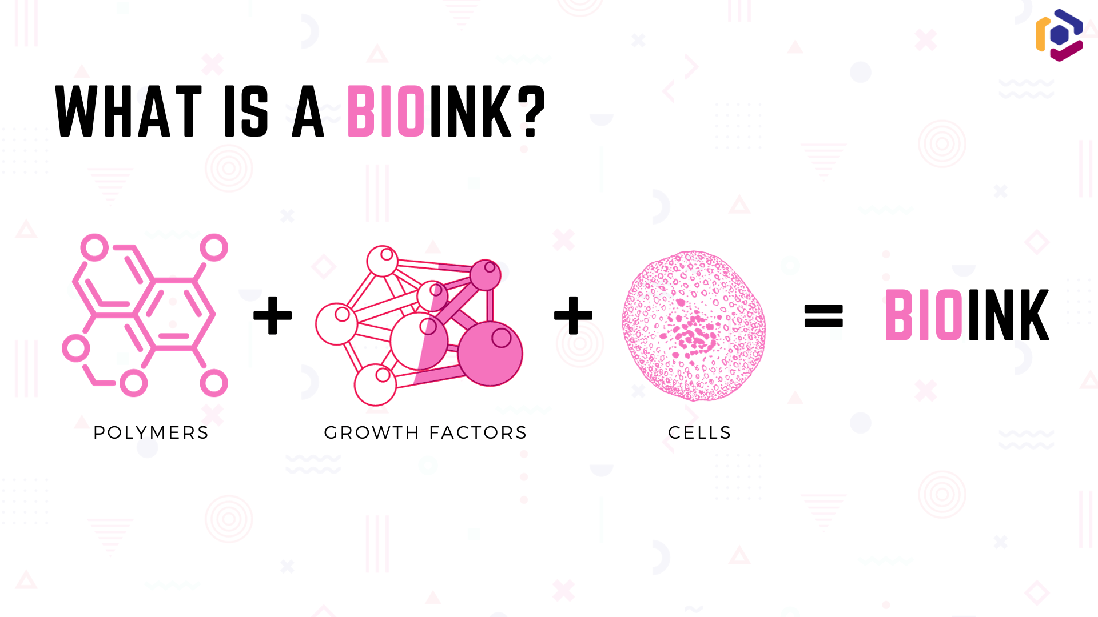
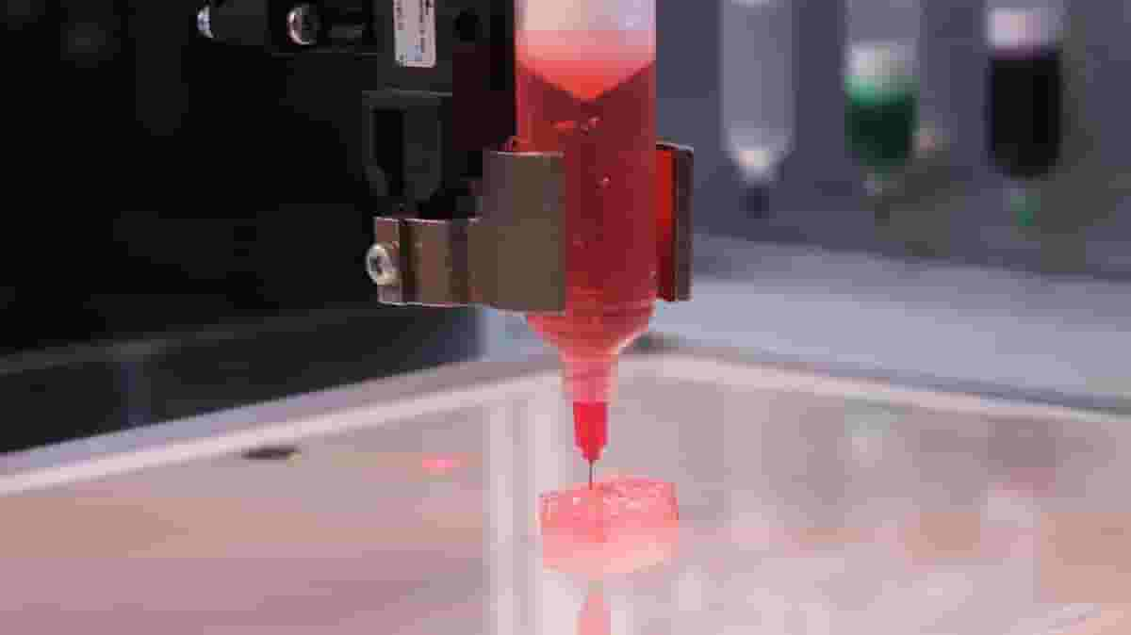
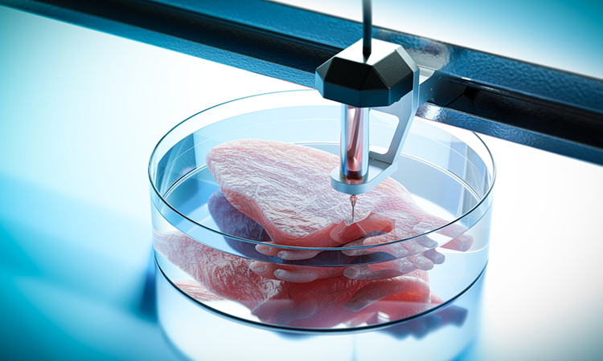
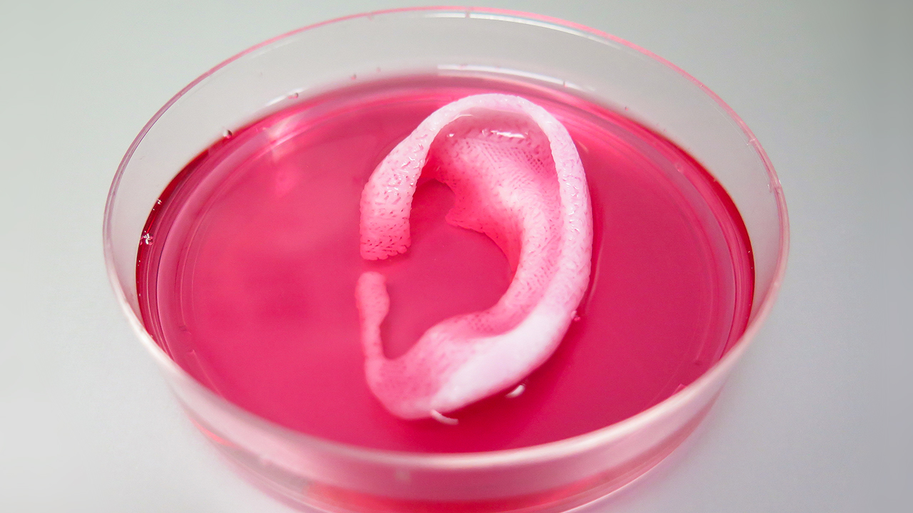
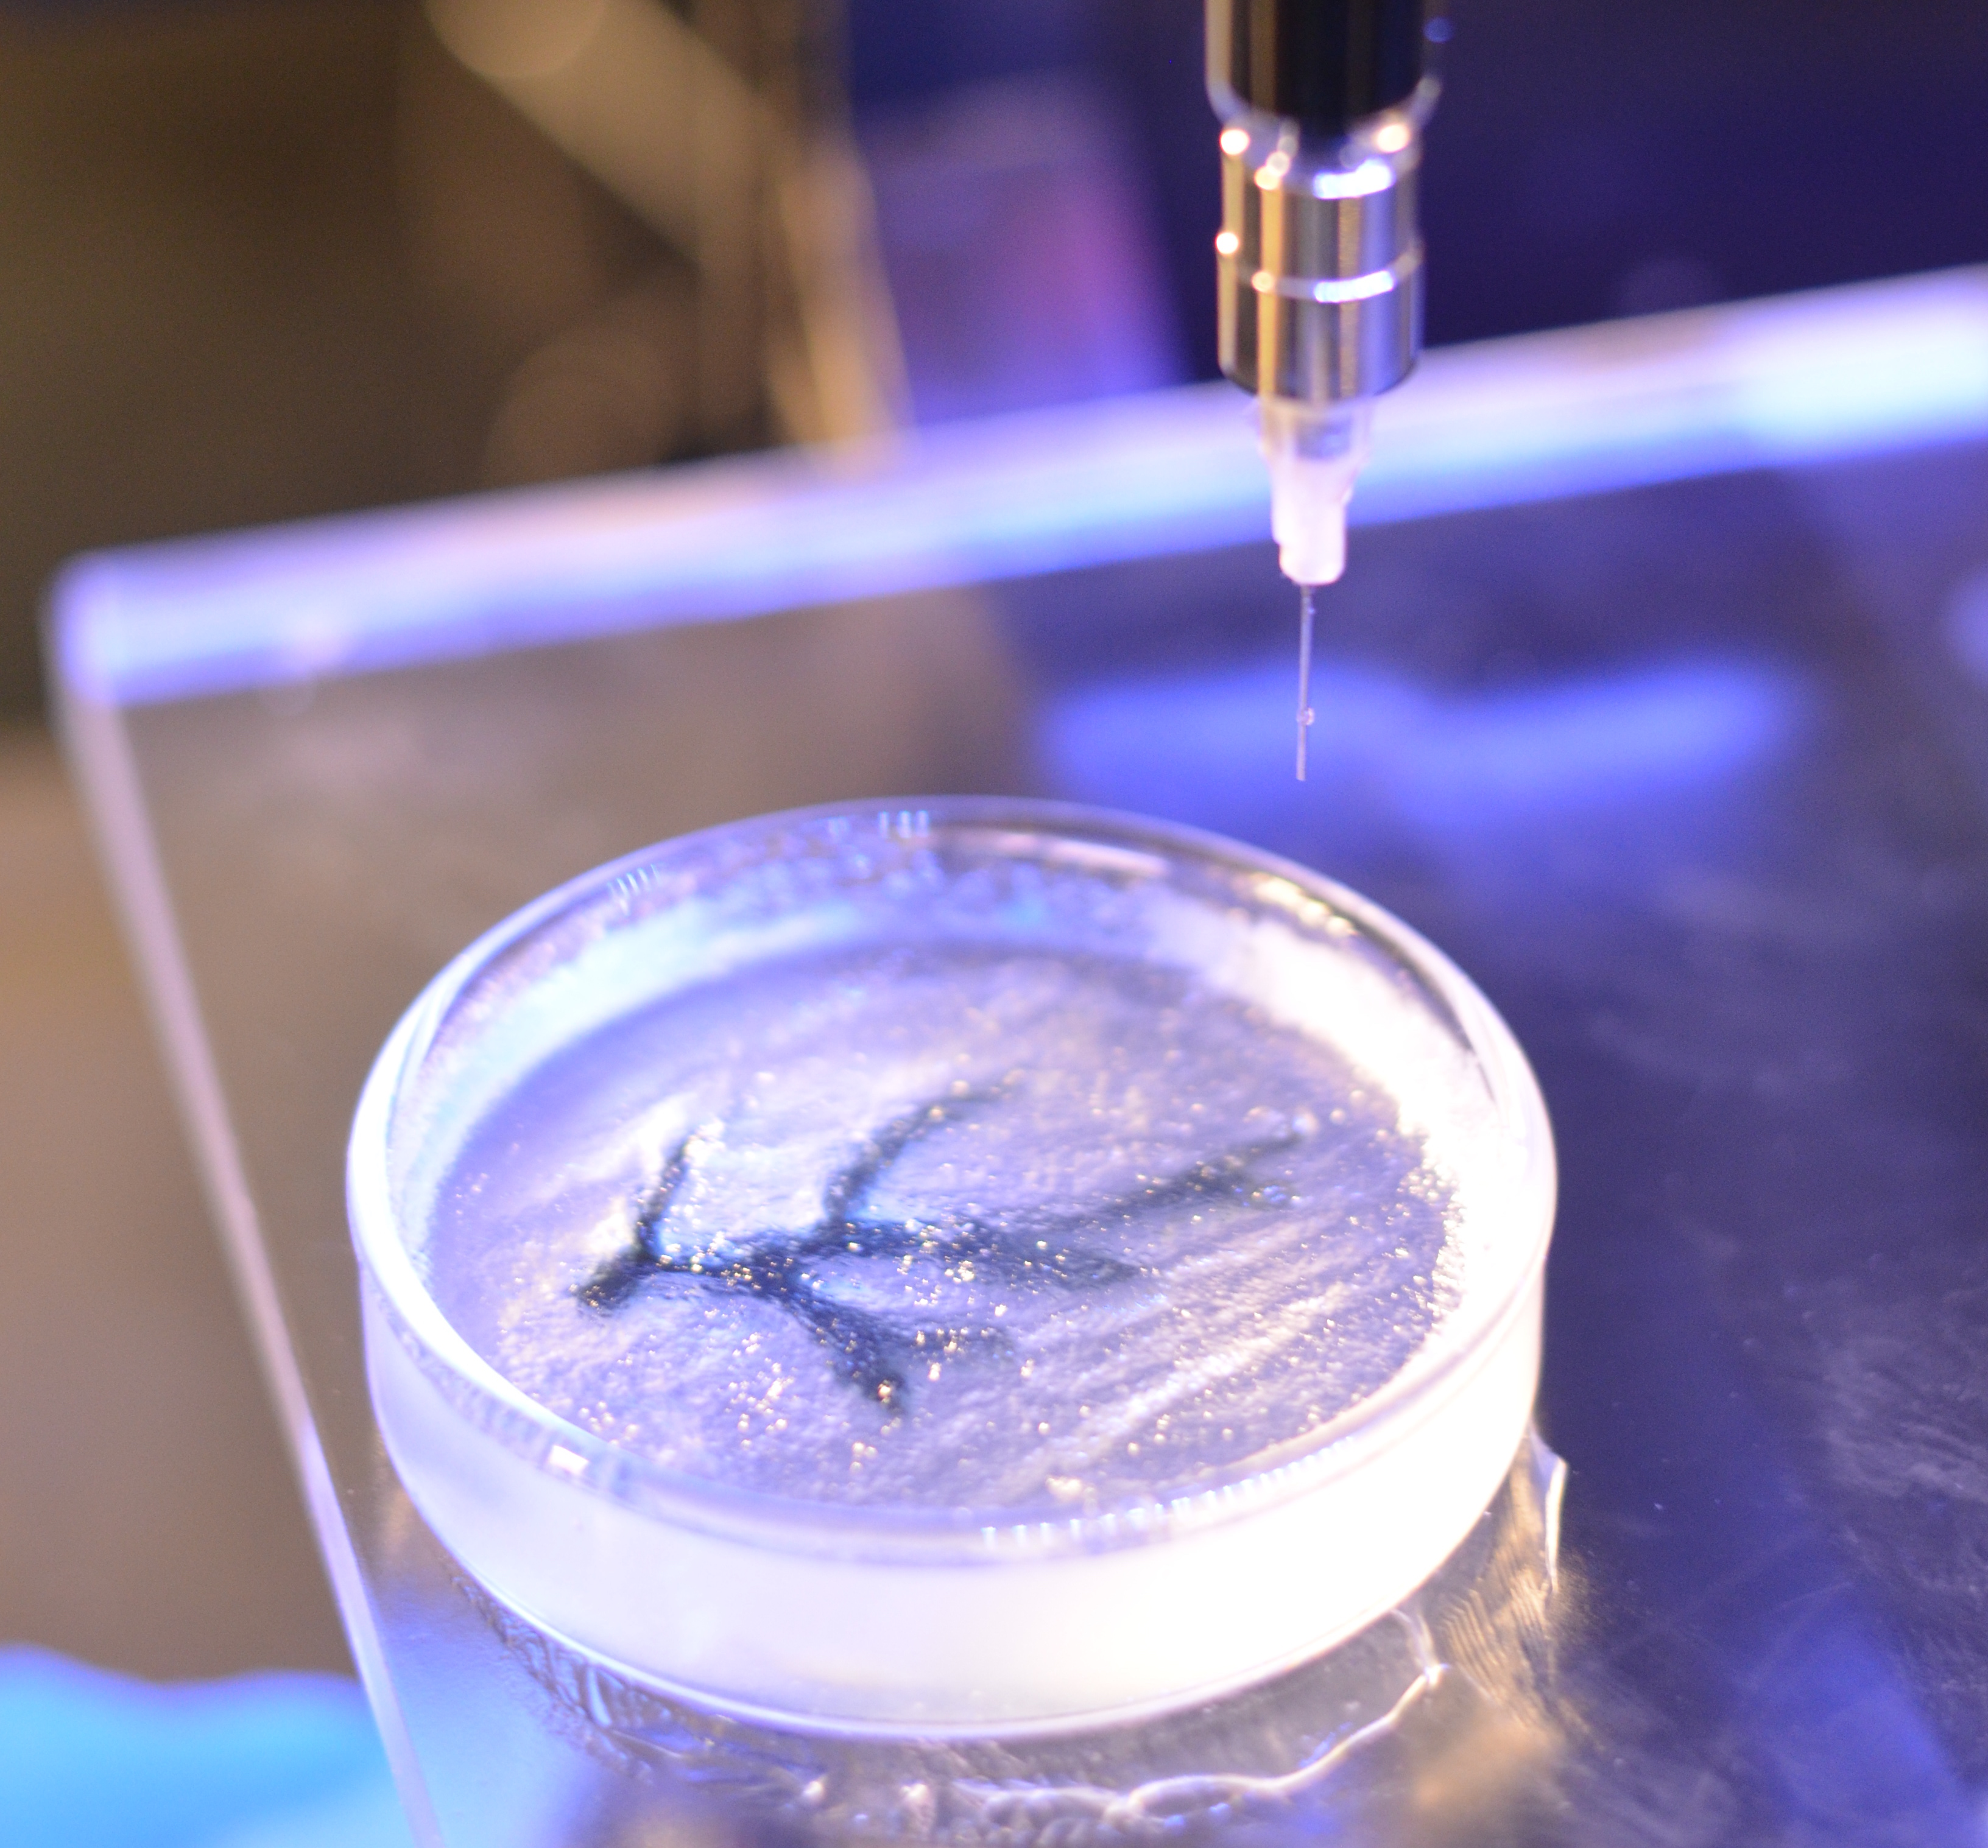
3d bIOPRINTING
https://www.researchgate.net/figure/Difference-between-bioink-and-biomaterial-ink-
In-bioink-cells-are-compulsory-components_fig3_365145296
Uses “bioinks” – biocompatible materials and/or living cells
Creates 3D structures that mimic human (typically) tissues and organs
https://www.drugtargetreview.com/news/110266/3d-bioprinting-artificial-organs-could-become-quicker-and-easier/
https://nextbiginnovationlabs.com/bioinks-the-secret-sauce-of-bioprinting-for-building-your-tissues/
https://www.drugtargetreview.com/news/110266/3d-bioprinting-artificial-organs-could-become-quicker-and-easier/
https://www.science.org/content/article/tissue-printer-creates-lifelike-human-ear
https://directorsblog.nih.gov/2015/11/03/building-a-better-scaffold-for-3d-bioprinting/

Slide 15

Why 3d bioprinting matters (1)
A need for better models in drug testing and development
Average time: 10-15 years
Average cost: $1.3 billion (JAMA study)
N-SIDE: true cost may be closer to $2.6 billion, if you include both direct and indirect costs
3D bioprinting can generate more efficient & cost-effective drug testing methods

Slide 16
Why 3d bioprinting matters (2)
Decrease the need for animal testing and research
Can provide human-like models
Can generate a more ethical & scientifically relevant approach

Slide 17
Why 3d bioprinting matters (3)
Can help usher in an era of personalized & regenerative medicine
Can help develop patient-specific implants, tissues & drug delivery systems
Can generate custom-made prosthetics, personalized drug formulations & patient-specific disease models for research & treatment development

Slide 18
Why 3d bioprinting matters (4)
Eventually, to address a severe shortage of donor organs & tissues
Can/may be able to use a patient’s own cells to build organs or tissue grafts
This will minimize the risk of organ rejection and the need for life-long expensive and debilitating immunosuppressive drugs for organ transplant recipients

Slide 19
Current progress/challenges & Future perspectives
Dr. Thomas Grundy, Whitney Symons and Hannah Roddy) (Inventia Life Science)
Dr. Jay Hoying (Advanced Solutions Life Science)

Slide 20
Student Perspective: Zoe Panagos
Rastrum Greenlighting Demo

Slide 21
THANK YOU
Daniel Kainer
(936) 273-7060
Daniel.B.Kainer@lonestar.edu

