Slide 1
Have We “Flipped” Over “Crowdsourcing”?
Image Source: Kindle ad
Vivian Colias Jones, CAC, LSC-Montgomery, Texas, 3 October 2012
http://montgomerycac.wordpress.com/presentations/

Slide 2
1. Mobile Learning
“Any activity that allows individuals to be more productive when consuming, interacting with, or creating information, mediated through a compact digital portable device that the individual carries on a regular basis, has reliable connectivity, and fits into a pocket or purse” (Wexler et al., qtd. in Quinn, C. The Mobile Academy: mLearning for Higher Education, 2011).
mLearning: Getting Past the Novelty, Vivian Colias Jones and Panel [Debbie Ellington, Carolyn Poe, Julie Harless, Jared Cootz] , CAC, LSC-Montgomery, Texas, 1 Feb. 2012; http://montgomerycac.wordpress.com/presentations.

Slide 3
New technologies enter our lives and society in four stages
It will kill us all!
It will steal my daughter!
I’ll never use it!
What are you going on about?

Slide 4
2. BYOD: Bring Your Own Device
IS WI-FI OR CELLULAR
IS NOT
BYOD in Higher Education
King’s College
Sao Paolo St. U.
Seton Hill U.
U. of Tenn. At Knoxville
U. of S. Florida
Bring your own drink.

Slide 5
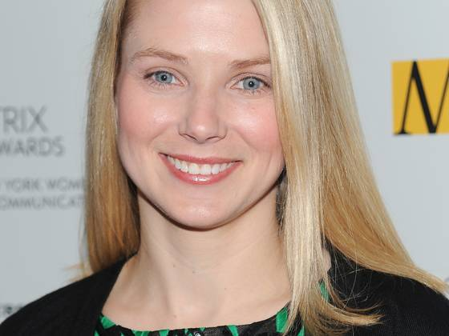
Yahoo CEO Marissa Mayer
"She's crowdsourcing suggestions for Baby Boy Bogue's name!" tweeted New York University journalism professor and blogger Jeff Jarvis, one of the recipients of Mayer's group email "How digital can you get?"
http://www.usatoday.com/story/tech/2012/10/01/yahoo-ceo-adds-motherhood-to-list-of-challenges/1606325/

Slide 6
The Crowd
“I, who looked again, beheld a banner, Which, whirling round, ran on so rapidly, That of all pause it seemed to me indignant; And after it there came so long a train Of people, that I ne'er would have believed That ever Death so many had undone.” Dante, Inferno, Canto 3
Hoi polloi, the many, the majority, a crowd
Focus group
Democratic assembly
The masses, the working class, commoners, a mob, the crowd (which leads to crowd control)

Slide 7
3. Crowdsourcing
IS
IS NOT
An appeal to a group with a common purpose
Wikipedia
A collection of teaching materials on a common platform/site
A textbook based on focus group feedback (4LTR, Cengage: COMP: Write, Write 1, and Write 2)
Open source coding, Linux
“Outsourcing” to a group
Crowdsourcing explained by Common Craft, http://www.commoncraft.com/video/crowdsourcing, 1 year individual faculty membership $159; 2-50 at $319
An appeal to an individual, as in the “citizen journalist”
YouTube, Slideshare, Vimeo (video)
Instagram, Flickr (image)
Facebook, Twitter (social)
Pulse, Instapaper, Pocket (news)
Pinterest, Learnist, Educlipper, ScoopIt
Evernote, Dropbox

Slide 8
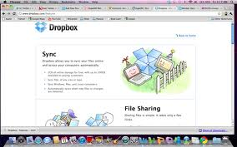
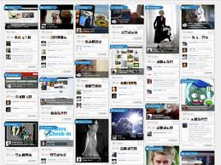

Slide 9
4. Content Curation
What are the shared purposes of moving teacher files to online sharing?
Syllabi
Textbooks
Visuals
Activities
Assessments
Rubrics
Sources
What is the best way to integrate other social media platforms in more compelling ways, versus simply sharing boards?
What is the possibility for deeper collaboration–between board collaborators, and the users of the board? http://www.teachthought.com/learning/5-ways-learnist-has-evolved-digital-learning/

Slide 10
5. Crowdfunding
Definition
Examples
An “informal, collective effort to raise funds from different sources and individuals via online networks” EdSurge
Outside the structure of venture funding.
Startup America (The White House)
Kickstarter
Organizations like DonorsChoose, AdoptAClassroom, TeacherWishLists, and ILoveSchools provide a channel for teachers to seek the funding

Slide 11
6. Flipped Classroom
“A model that promotes using class time for tutoring, and home time for lectures via video. Popularized by Khan Academy.” EdSurge
Motto: Learn Almost Anything for Free
Primarily Math, Science, Computer Science, Finance & Economics
Thousands of instructional videos and/or practice exercises; individuals track their progress
See Wired, 4 April 2012
Has entered mainstream as an educational practice
Note this subtitle: “Reach Every Student in Every Class Every Day”
➔ Blended Learning
Notes:
Blended Learning: Scale and Impact, Thomas Cavanaugh, U. of Central Florida, iStream, Innovation Spotlight, 19 Sept. 2012

Slide 12
7. Disruptor, Disruptive, Disruption
Background
What catches my eye:
Disruptive innovation theory, explained in 7m. video http://www.claytonchristensen.com/key-concepts/
Often for-profit
Usually online like
Udemy
Here's a refresher from the New Republic succinctly framing Udacity, MITx, and other pioneers in online learning in the context of Clayton Christensen's disruption theory, and why many pundits see an increasingly viable threat to the monopoly of official degree-conferring institutions. For instance, check out David Wiley's argument for why learning outcomes-aligned badges (LOBs) make sense, particularly in higher-ed. Edsurge, https://www.edsurge.com/n/trends-cliff-notes
“The Higher Education Monopoly Is Crumbling As We Speak,” http://www.tnr.com/article/politics/101620/higher-education-accreditation-MIT-university
Unschooling, Uncollege

Slide 13
8. MOOC: Massive Open Online Courses
Definition & Question
Examples
“…classes that are taught online to large numbers of students with minimal involvement by professors. Typically, students watch short video lectures and complete assignments that are graded either by machines or by other students. That way a lone professor can support a class with hundreds of thousands of participants.” Chronicle of Higher Education,
http://chronicle.com/article/What-You-Need-to-Know-About/133475/
Will they democratize higher education and end the era of overpriced colleges?
edX (MIT, Harvard, Berkeley, nonprofit)
Coursera (began by Sebastian Thrun, AI graduate class from Stanford with 160K students in 190 countries, now Princeton and U. of Virginia, and others, for profit)
Udacity (computer science and related, for profit )
Udemy (lets anyone set up a course, for profit)

Slide 14
9. Maker Movement
DIY (do it yourself)
People make and show (and possibly sell)
Etsy
Maker Magazine => Maker Faires
Austin, Lubbock, Shreveport
Tech-savvy makers => SXSWedu 2013, March 4-7 in Austin, Texas
Edupreneur
Giant to small investors in education
Ideas anyone? => encore
How might gamification be used in a substantive way to track learning results or long-term knowledge accrued?
How might content curation help teachers find materials they need?

Slide 15
10. Badges
“Congratulations, You have earned the Welcome Aboard badge! You activated your account on Lose It! Welcome aboard!”
“A way to recognize progress toward a goal--and increasingly a product design method. Tools (or platforms) tagged with the Badges topic use badges as a central part of their reward system.” EdSurge https://www.edsurge.com/badges#/default

Slide 16
Personal Learning Network (PLN)
EdSurge (newsletter subscription) for news, product reviews, & events; login to website https://www.edsurge.com/
Pulse
Allows me to read in one place on iPad and web
“Save to Pulse” widget
To record my ideas, I write in Day One, speak in QuickVoice, & save references in Dropbox
Where Vivian learns about edtech…
Organizations & Conferences: ISTE, Computers & Writing, NCTE, Madison Distance Learning Conference
Wired Magazine
Read, Write, Web
Engadget
All Things Digital
AppAdvice
Gizmodo
CNET
Macrumors
Macstories
Macworlds
Fast Company
Readability Top Reads
Plans for the future…Assemblee, Educlipper, Learnist, Edmondo, LinkedIn Twitter, Etsy, Ecommerce

